Slide 1


An excellence based curriculum for the Improvement of LEAN & GREEN Management Skills in SME
Advisory board meeting 4/06/2025

Slide 2
Time | Session | Content & Objectives | Presenter / Partner Responsible
14:00–14:10 | Welcome & Agenda Overview | Introduction to the session, expected outcomes, and participant roles | GAIA (Project Coordinator)
14:10–14:25 | Project Overview & Key Achievements | Summary of project background, goals, and achievements across WPs (IO1, IO2, IO3) | GAIA
14:25–14:40 | Presentation of the Integrated ExCurS Solution | Overview of the platform and how it integrates the self-assessment tool, training modules, | IBK+ GAIA
14:40–14:55 | Short Refreshment Pause
14:55–15:25 | Stakeholder & Advisory Board Feedback Round | Open discussion: impressions, improvement suggestions, usability feedback | Facilitated by GAIA +IBK
15:25–15:40 | Discussion on Transferability and Sustainability | Outlook on how the solution can be transferred to other regions/sectors and maintained beyond the project | IWSI
15:40–15:45 | Closing & Next Steps | Wrap-up of feedback, timeline for final adjustments, and planning for project closing conference | GAIA

Slide 3
Project Overview & Key Achievements

Slide 4

ExCurS Project: Improving Lean and Green Management Skills in SMEs
The ExCurS project (An Excellence-based Curriculum for the Improvement of LEAN & Green Management Skills in SMEs) is an Erasmus+-funded initiative that seeks to create a vocational education training program focused on LEAN and green management skills for small and medium-sized enterprises (SMEs).
This 36-month project (2022-2025) brings together six organizations from five European countries to develop self-assessment tools and training modules that enable SMEs to identify their transformation needs and exploit the opportunities of the green economy and digitalization.
BB

Slide 5






Project Context and Motivation
Digital Transformation
Critical need for business competitiveness
Green Economy
Adaptation to European environmental policies
Lean Management
Process optimization and waste reduction
Many SMEs face significant barriers to addressing current challenges such as digital transformation and the expansion of product creation processes toward a circular economy. The COVID-19 pandemic accelerated the trend of shifting administrative and production tasks to remote work, but many companies are limited to supporting existing processes with ICT tools instead of redesigning them to maximize the benefits of digital environments.

Slide 6




Objectives of the ExCurS Project
Survey existing offers
Identify and catalogue existing management support tools and methodologies
Identify needs
Develop self-assessment tools to identify potential for improvement
Create training
Design learning modules tailored to specific needs
Implement solutions
Facilitate the transformation towards sustainable organizations
Validate results
Test solutions with pilot organizations
The overall objective of ExCurS is to create a vocational education training program that allows vocational education and training to be tailored to the needs of the labor market. The project seeks to develop a work-based blended learning concept, implemented through an online platform that can be used by any interested party.

Slide 7
Participating Organizations
Coordinator: GAIA (Spain)
Academic Partners
Business Partners and Associations
Knowledge and Technology Industries Association representing more than 304 companies in the ICT sector in the Basque Country. Its mission is to promote development and growth in the engineering, consulting, electronics-IT, and telecommunications sectors.
University of Reutlingen (Germany) and University of Split (Croatia), higher education institutions with extensive experience in research and training in digital transformation and industrial engineering.
IBK Management Solutions (Germany), Irish Work Study Institute (Ireland) and Mindpedia (Romania), which provide expertise in consulting, professional training and software development.
This combination of partners ensures a multidisciplinary and complementary perspective, encompassing different political systems, work cultures, economic fields, and core competencies. International collaboration offers the potential to create networks between companies located in different European regions.

Slide 8





Expected Results of the Project
Self-Assessment Tool
Concept of Blended Learning
A quick and easy-to-use self-assessment system based on the EFQM 4.0 model/EFE, which allows you to identify existing gaps and derive a roadmap based on environmental sustainability.
A training approach for managers and staff, based on Work-Based Learning (WBL) principles, that develops professional, cognitive, and digital skills.
Online Platform
Complementary Resources
A validated platform that includes self-assessment tools, best practice roadmaps, and training at regional, European, organizational, and individual levels.
Library, glossary, guidelines for trainers, and documented use cases that facilitate the implementation of solutions.

Slide 9

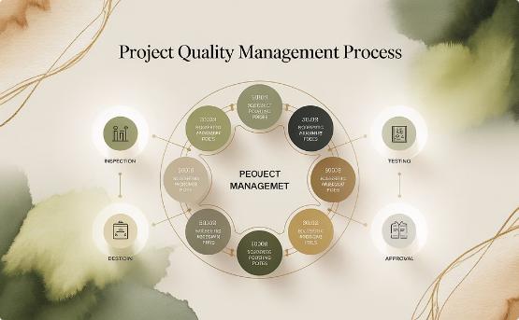

Project Management Structure
Tripartite Structure
Quality Management
Risk Management
The project will be managed by a tripartite governance structure consisting of the Project Coordinator (PC), a Project Board (PB), and a Technical Board (TB). This tripartite governance structure will be advised by an independent Advisory Board (AB).
In addition to monthly and quarterly reports, the Quality Gate process plays an important role in partner engagement regarding the timeliness and quality of project deliverables. Each of the major deliverables (Intellectual Outputs) is internally validated through a Quality Gate.
The project manual includes a contingency management protocol to address foreseeable risks to the project, such as the imposition of a "national lockdown" within the jurisdiction of a consortium partner. Regarding conflict resolution, the PC will organize a conflict resolution meeting.

Slide 10
Project Schedule
Phase 1: Inception and Concept
Phase 3: Validation and Closure
December 2022 - December 2023
June 2025 - November 2025
Establishment of the Advisory Board, evaluation of methodologies, development of the self-assessment tool
Piloting with selected organizations, final adjustment, results conference, final reports
1
2
3
Phase 2: Development
January 2024 - May 2025
Design and development of training modules, platform adaptation, content localization
The ExCurS project has a total duration of 36 months, from December 2022 to November 2025. Activities are organized into three main phases, which are carried out sequentially but with some overlap to ensure continuity and the exploitation of synergies between the different work packages.
Project management and dissemination activities are carried out throughout the duration of the project, while the three main intellectual outputs are developed sequentially, with overlapping periods to ensure consistency and integration of results.

Slide 11
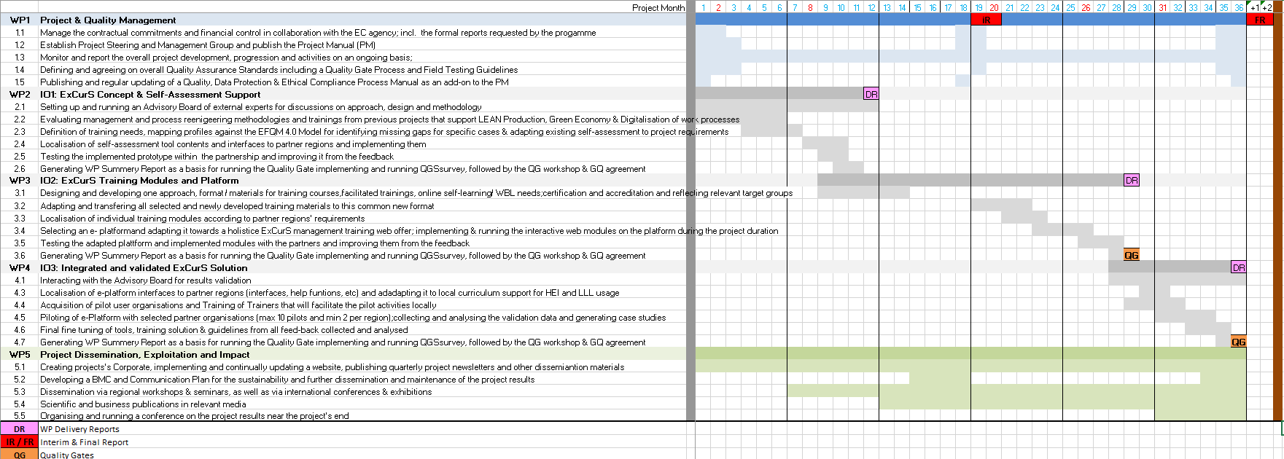

Slide 12
Work Package 1: Project Management
Coordination
Meetings
GAIA, as project coordinator, will be responsible for overall management, financial control, and communication with the National Agency.
Monthly virtual meetings of 1-2 hours and three in-person meetings: kickoff, mid-project, and closing.
1
2
3
4
Monitoring
Risk Management
Monthly status reports (MSR) and quarterly progress reports (QPR) for ongoing monitoring.
Contingency management protocol to address foreseeable risks and conflict resolution.
To ensure a consistently high level of performance, the consortium will establish a clear structure for project management and progress reporting. ExCurS's management and governance structures will monitor project progress against the plan and resolve any technical, administrative, or contractual challenges.

Slide 13
Work Package 2: ExCurS Concept and Self-Assessment Support
Localization and Testing
Tool Development
Adaptation of content and interfaces to partner regions, prototype testing, and incremental improvements.
Evaluation of Methodologies
Establishment of the Advisory Council
Mapping of skills profiles against the EFQM 4.0 Model, identifying gaps, and adapting the existing self-assessment to project requirements.
Analysis of management methodologies and process reengineering from previous projects that support LEAN production, the green economy, and digitalization.
Creation and management of a board of external experts for discussions on approach, design, and methodology.
This work package helps ensure that project outcomes help tailor vocational education and training to the needs of the labor market by developing a self-assessment tool that allows an organization to identify specific areas for developing its employees' knowledge and skills.

Slide 14








Work Package 3: Training Modules and ExCurS Platform
Design
Adaptation
Developing a common approach to training courses, e-learning, and certification needs
Transfer of selected and new materials to the common format
Implementation
Location
Selection and adaptation of e-learning platforms for the training offer
Adaptation of modules to regional partner requirements
The objective of this work package is to define the specific training environment and program that ExCurS will offer, deliver individual modules to populate the platform, adapt existing training courses to the new format, or develop new modules to address identified gaps.
All partners participated in the development of this work package, with GAIA as the leader, ensuring the execution of all tasks in cooperation with the other partners.

Slide 15
Work Package 4: Integrated and Validated ExCurS Solution
Validation with Experts
Curriculum Development
Piloting and Improvement
Interaction with the Advisory Board to validate results and gather expert feedback to ensure the quality of the solution.
Creating curricula for continuing vocational training (CVET) offerings and using them in higher education based on individual modules.
Acquisition of pilot user organizations, training of trainers, platform testing, collection and analysis of validation data.
Experts will provide guidance on the relevance of the content and the usability of the developed tools.
It includes the development of an ExCurS glossary, resource library, and guidelines for trainers on how to present training.
The feedback obtained will allow for the final adjustment of tools, training solutions, and guidelines to optimize the user experience.
The main objective of this work package is to pilot and validate the solution prototype in order to generate a stable release candidate at the end of the project, ready for external users.

Slide 16




Work Package 5: Dissemination, Exploitation and Impact of the Project
Corporate Identity
Business Plan
Outreach Events
Publications
Creation of the project identity, implementation and ongoing updating of the website https://www.excurs.eu/ , publication of quarterly newsletters and other outreach materials.
Development of a Business Model Canvas and Communication Plan for the sustainability, dissemination, and maintenance of project results.
Regional workshops, seminars, international conferences, and exhibitions to showcase the project's results.
Scientific and business articles in relevant media to increase the visibility and impact of the project.
This work package contributes to the overall project objectives by coordinating partners' outreach activities to generate the desired impact both during and after the project. The main outcome will be high visibility and recognition of the project results and the training solution developed.

Slide 17
Presentation of the Integrated Excurs solution

Slide 18
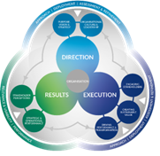
ExCurS
Original Solution: Corporate Excellence Assessment (based on EFQM)
Results for the 7 EFQM Criteria
1: Purpose, Vision & Strategy
2: Organisational Culture & Leadership
3: Engaging Stakeholders
4: Creating Sustainable Value
5: Driving Performance & Transformation
6: Stakeholder Perceptions
7: Strategic & Operational Performance
Introduction to
90+ on-topic management methods
Excellence
Assessment
Trainig offer platform with selected more in depth Modules (50+ on green
& digital skills)
Training delivery

Slide 19
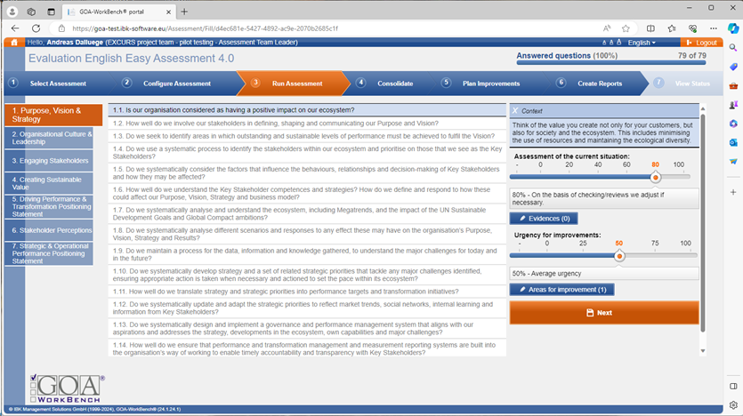
The Assessment Application

Slide 20
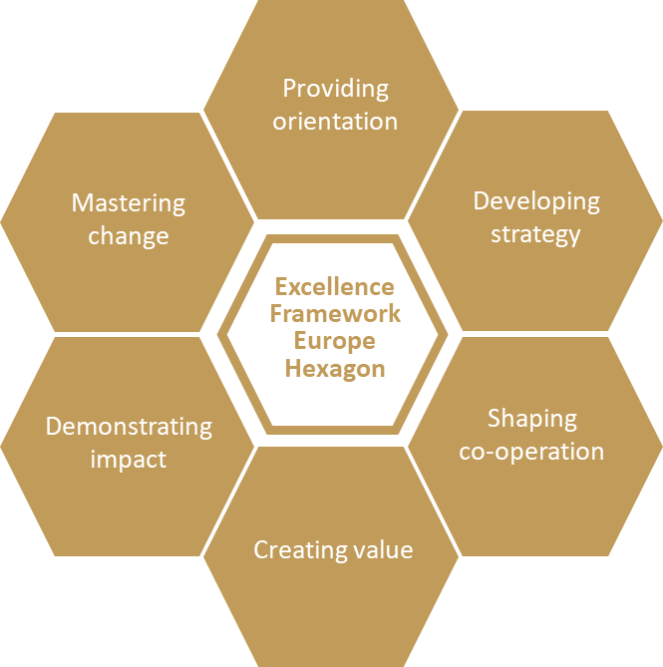
ExCurS
NEW Solution: Individual Training Needs Assessment (based on EFE)
Results for the 6 EFE Areas
A - Providing orientation
B - Developing strategy
C - Shaping co-operation
D - Creating value
E - Demonstrating impact
F - Mastering change
Introduction to
90+ on-topic management methods
Training Needs
Assessment
Trainig offer platform with selected more in depth Modules (50+ on green
& digital skills)
Training delivery

Slide 21
Training
Training needs
Curriculum Development
Piloting and Improvement
Definition of training needs, mapping profiles against the EFQM 4.0 Model for identifying missing gaps for specific cases & adapting existing self-assessment to project requirements
Designing and developing one approach, format / materials for training courses, facilitated trainings, online self-learning/ WBL needs;
Adapting and transferring all selected and newly developed training materials to this common new format
Localisation of individual training modules according to partner regions' requirements
Selecting an e- platform and adapting it towards a holistic ExCurS management training web offer; implementing & running the interactive web modules on the platform during the project duration
The training is divided in 12 modules in all languages and 39 training modules as additional material just in English

Slide 22
Training
Nº | Modules available in all languages (12 MODULES)
1 | Connected company / Smart factory | 2
2 | Customer requirement matrix (QFD) | 1
3 | Data-enabled resource optimisation | 1
4 | Digital Assistant systems | 2
5 | Digital Twin of the facility | 2
6 | KPI Analysis (GAIA)- Key Performance Indicators | 1
7 | Predictive maintenance | 1
8 | Process identification and mapping | 2
9 | Benchmarking /CONTINUAL IMPROVEMENT & BENCHMARKING | 3
10 | Digital Human Resource Management | 2
11 | EU_UN_ILO polices combined | 2
12 | Brainstorming | 3

Slide 23
Nº | Modules available only in English (38 MODULES)
13 | Change Management | 1
14 | Collective leadership | 1
15 | Communication Analysis | 2
16 | Communication and relationships (including cross-cultural communication) | 1
17 | Critical Success Factors | 3
18 | Decentralised & flexible value creation | 1
19 | Digital twin of the assets | 2
20 | Financial Risk Management | 2
21 | Integrated transparent value chain | 2
22 | Internal Information Database | 2
23 | Manager as a coach | 2
24 | Measurement of processes | 1
25 | Risk and Scenario Planning | 2
26 | Stakeholder Management | 3
27 | Stakeholder Mapping | 2
28 | Strategy/Value-Matrix | 2
29 | Target Setting | 2
30 | Technology Needs Analysis | 1
31 | Time (self) management | 2
32 | Track and trace | 2
33 | Communication Plan | 3
34 | Data driven decision making (incl. process optimisation) | 3
35 | GROW-Model (Coaching) | 4
36 | Scenario Management | 4
37 | Stress Management & RESOURCE BUILDING | 1
38 | Balance Score Card | 3
39 | FMEA- Failure model and effect analysis | 3
40 | Cause and effect diagram | 3
41 | Customer relationship management | 3
42 | Stress Management methodology
43 | Background knowledge
44 | General information
45 | General information on resources
46 | Principles of health and safety at work
47 | Physical health
48 | Change, flexibility and adaptability
49 | Communication and empathy
50 | Self-reflection and self-awareness
51 | Emotion regulation

Slide 24
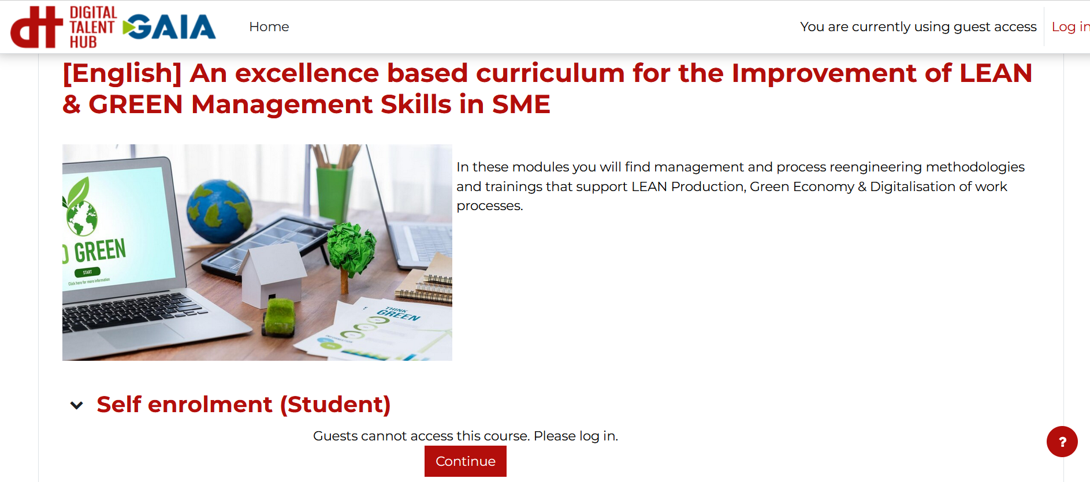
https://training.gaia.es/enrol/index.php?id=8

Slide 25
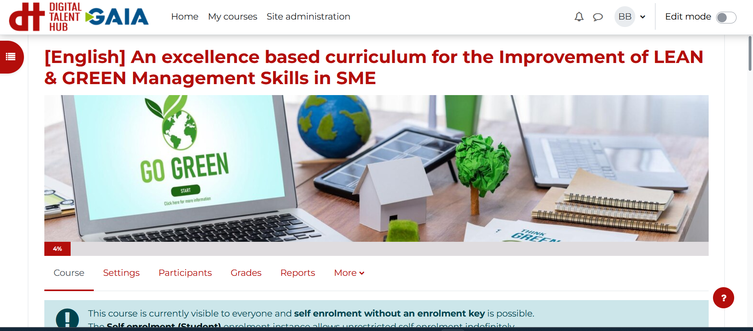

Slide 26
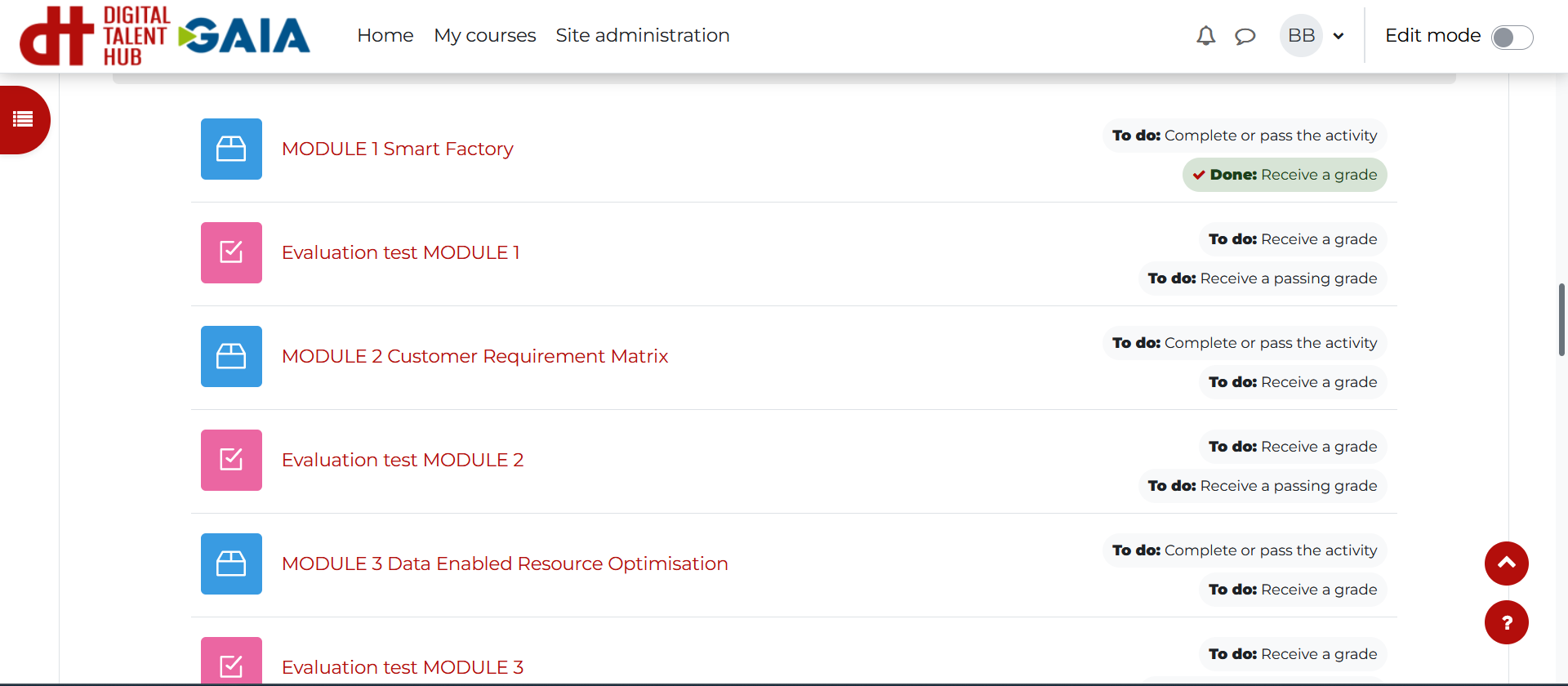

Slide 27
Stakeholder & advisory board Feedback round

Slide 28
Discussion of transferability and sustainability

Slide 29
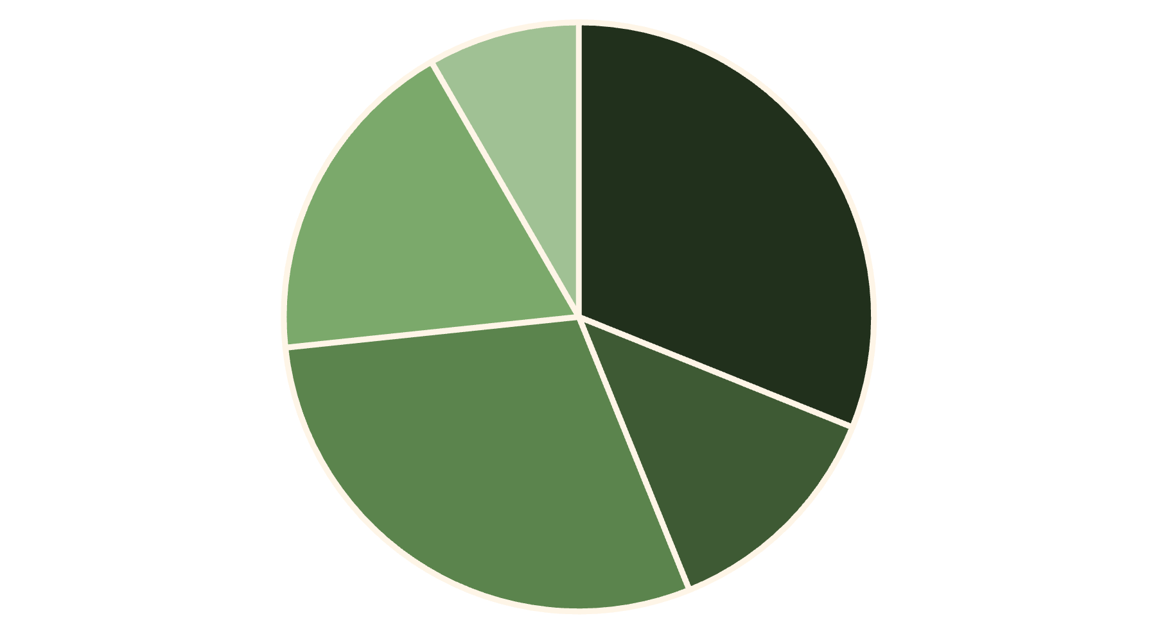
Needs Analysis
Lack of digital strategy
Perception as a cost
Lack of qualified personnel
Technological ignorance
Other factors
There are several drivers for the continued digitalization of work. The biggest of these is the overall improvement of technology. Digital transformation requires many different changes, including new work tools and the training of competent employees to use them.
A 2015 study of 302 European companies examined the current state of digitalization development, revealing that most had not implemented pilot projects to advance digital transformation. At the same time, a third of these companies could not determine the responsibility for such projects within the organization.
According to a 2016 study, 53% of 211 companies surveyed considered employee
qualifications to be one of the key factors in improving digital transformation.

Slide 30



Project Target Groups
SMEs
Small and medium-sized businesses that lack the financial resources to hire consultants or maintain their own expert departments in digitalization and intelligent systems. ExCurS will provide them with self-assessment tools and training tailored to their specific needs.
Training Providers
Higher education institutions (HEIs) and continuing vocational training (CVET) providers seeking to enhance their training offerings will be able to integrate the project's results into their curricula and study programs.
Sectoral Associations
Organizations that represent groups of companies and can act as multipliers to disseminate project results. These include chambers of commerce, professional associations, and business networks.
ExCurS is particularly aimed at SMEs due to the needs mentioned above. Unlike large companies with their financial strength, SMEs lack the same economic opportunities and therefore lack experience, insight, and knowledge regarding technologies, methods, and approaches.

Slide 31
ExCurS Project Innovation
Integrated Approach
Customized Solutions
Accessibility and Inclusion
ExCurS combines the results of previous projects to create synergies between different fields of education and practical training. It integrates approaches, methods, and tools based on Business Excellence, Industrial Engineering, and policy instruments that support digital transformation and environmental sustainability.
The system allows for the configuration of customized, ad-hoc solutions for individual user groups, tailoring materials to meet the specific needs of a given situation. This maximizes the relevance and applicability of the training.
The approach and methodology consider an accessible and inclusive approach to activities, designed to be open to people with fewer opportunities. A common way to do this is to implement "simple language" that makes the results accessible regardless of educational level.
All international project partners already have access to a wide range of training materials with intellectual property rights belonging to them. This provides access to a comprehensive set of training modules and content tailored to the digital transformation and environmental sustainability requirements of SMEs within the project.

Slide 32



Added Value at European Level
Transnational Collaboration
Five countries with different systems and cultures
Knowledge Transfer
Exchange of best practices between regions
European Impact
Contribution to the competitiveness of European SMEs
The combination of partners and the Advisory Board ensures that ExCurS is not limited by national or sector-specific policies in its understanding and transfer of knowledge. The partners represent five different European countries, with distinct political systems, work cultures, economic fields, and core competencies.
The international cooperation of NGOs, higher education institutions, and continuing vocational training providers offers the potential to create networks between companies located in different European regions, adding the potential for transregional knowledge transfer, thus strengthening the economic relationships of SMEs in Europe and the long-term prosperity of European society.

Slide 33
Regional and European Impact
Regional Impact
European Impact
Provide access to waste reduction measures for SMEs and vocational training organizations
Promote the use of management tools oriented towards Business Excellence and LEAN/green
Improve local use and understanding of Business Excellence and LEAN/green business
Validate a new methodology that links Excellence with LEAN and green technologies
Raise awareness among companies about the need for a more sustainable approach to business management
Support the European Green Deal by ensuring that relevant skills and competences are available in the workplace
Once validated, all results will be made available to the general public under the Creative Commons license, and the articles will be published as Open Access. This will ensure maximum dissemination and utilization of the knowledge generated by the project.
The multidisciplinary expertise and international network of partners will make the results available in a wide range of countries, thus contributing to the competitiveness of European SMEs.

Slide 34




Project Sustainability
Integration into Educational Programs
Continuous Use of Tools
Higher education and vocational training partners will integrate the training modules into continuing professional development programs for staff and study skills programs for students.
The self-assessment tool will be used as part of the induction program for staff and students, ensuring its continued use beyond the funding period.
Broadcasting Networks
Long-Term Collaboration
The NGOs will leverage their extensive network to initiate the adoption of LEAN and green training content by their peer organizations, expanding the project's reach and impact.
ExCurS will contribute to a long-term partnership between partners to develop collaborative expertise in this field that can then be shared and promoted across the EU.
The involvement of higher education and vocational training partners in this project will ensure that their respective organizations are fully committed to the long-term support and sustainability of the solutions generated through the ExCurS collaboration.

Slide 35
Dissemination and Promotion of Results
3+
20+
Academic Articles
Web Links
Publications in scientific journals
Sites with links to the project
30+
11+
Social Publications
Events
Posts on professional networks
Outreach activities
The project results will be made available under Creative Commons licensing regulations to allow external stakeholders to use the resources developed during this project. The Universities of Reutlingen and Split will leverage their extensive national and international partnerships to share ExCurS solutions with higher education institutions across Europe.
IBK will use his position as a visiting professor to promote ExCurS resources to a pan-European range of universities and through his extensive network of professional organizations in the context of management training. Mindpedia and the two NGOs that also act as vocational training providers will use the developed solution as part of their future training offerings.

Slide 36
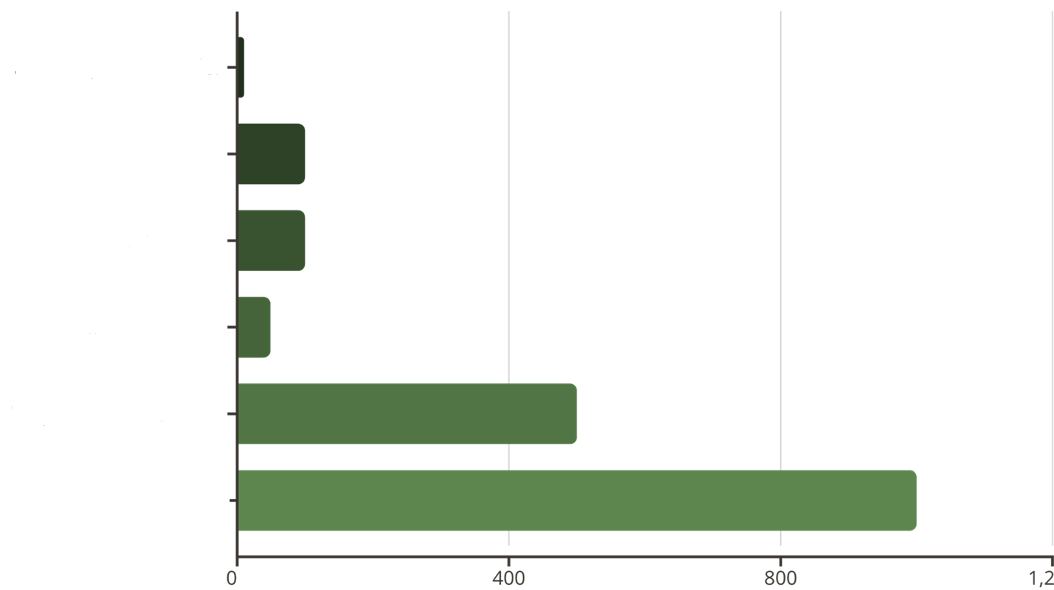
Project Impact Assessment
The first formal test of achieving the project's objectives will be passing the Quality Gates.
Additionally, achieving the aforementioned impact indicators will confirm the project's success.
Promotional events
Other important indicators include: number of modules adapted or developed (>50), number of conference presentations (>5), press reach (>5 articles, radio interviews), social media activity (>100 posts, impressions, likes, shares, etc.), and adoption of policies, procedures, or practices as a result in higher education or continuing professional development institutions (4 or more).
Event participants
Trained students
Trained trainers
Survey answered
Platform visits

Slide 37
KPI | FINAL NUMBER | GAIA 30/03/25 | EXCURS | HSRT | SPLIT | IWISI | IBK | ACTUAL STATUS
Number of promotional events | >10 | 8 |  | 2 |  | 10 | 2 | 22
Number of event attendees | >100 | 1065 |  | 80 |  | 8000 | 30 | 9175
Number of students trained | >100 |  |  |  |  |  | 25 | 25
number of educators/ facilitators trained | >50 |  |  |  |  |  | 15 | 15
Number of suvery responses | >500 |  |  |  |  |  | 0 | 0
Number of modules adapted or newly developed | >50 |  |  |  |  |  |  | 51
Number of hits to e-platform | >1000
Number of peer review papers accepted | >3 |  |  |  | 2 |  |  | (Split/HRST)
Number of conference presentations | >5 |  |  |  | 2 | 2 | 1 | 1 (Split/HRST/CAD)
Press reach | >5 | 3 newsletters |  |  |  | 1 |  | 3
Social media | >100 | 4 post - 4500 audience | 25 post - 1895 reacciones
Adoption of policies, procedures | >4 |  |  |  |  |  |  | lessons learned

Slide 38

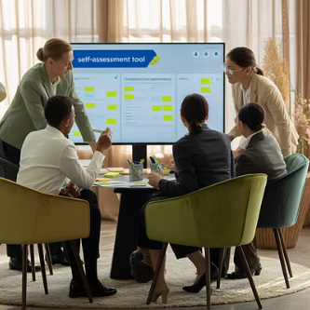



Piloting and Validation Activities
The ExCurS solution will be piloted with 8-10 user organizations, including higher education institutions, continuing vocational training providers, or industrial organizations with internal training departments. The target number of participants trained as part of the pilot is approximately 200.
Piloting activities will include the acquisition of pilot user organizations, training of trainers who will facilitate the pilot activities locally, testing the platform with selected partner organizations, collecting and analyzing validation data, and generating case studies.

Slide 39




Expected Long-Term Results
Organizational
Educational
Environmental
Collaborative
Improving the competitiveness of European SMEs through digital and green transformation
Adaptation of vocational training to the needs of the labor market
Contribution to the objectives of the European Green Deal
Strengthening transnational knowledge networks
The primary expected impact of ExCurS will be a training program in lean and green management skills for use in higher education and continuing professional training, promoted through a new organizational and pedagogical framework based on the use of self-assessment tools for company-specific delivery, guidelines, and resources.
Participants will learn new skills and gain a greater appreciation and understanding of how to improve their environmental impact and support their current or future organizations in better contributing to environmental sustainability. They will learn to use ExCurS self-assessment tools and guidelines to shape high-quality LEAN and green production or service environments.

Slide 40







ExCurS Project Summary
Training
Platform
Work-based blended learning modules
Integrated and validated solution in multiple languages
Self-assessment
Sustainability
Tool to identify skill needs and growth potential
Support for the green transformation of European SMEs
2
ExCurS aims to offer a self-assessment tool that combines organizational skills and knowledge needs for strategic growth with an individual's personal development plan, based on an assessment of existing and future potential.
This concept will be validated through the delivery and piloting of a training program focused on teaching lean and green management skills to SMEs, thereby supporting the new EU Green Deal and, through its hybrid training structure, digitalization efforts.
The project will develop management methods adapted to the EFQM 4.0 model and the Green Deal to align personal development with organizational growth plans through self-assessment, blended learning for managers and staff, and a validated online platform offering the integrated solution in the partner languages.

